Slide 1

Data Structures
Presented by:
Elizer Ponio Jr.

Slide 2

Are you a neat freak?
Notes:
Let me tell you a story
During the covid 19 pandemic.
too small, too big, too cluttered rooms

Slide 3
Why do people organize?
To feel a semblance of control
To know where things are without searching
People find comfort in predictability.
Notes:
Have you asked yourself the question, why do people organize?
Lets go to the psychology of organizing
This predictability applies within the context of our homes, manifesting through the concept of organization

Slide 4
What is a Data Structure?
A storage that is used to store and organize data.
It is a way of arranging data on a computer so that it can be accessed and updated efficiently.

Slide 5
Types of Data Structures
Linear data structure
Non-linear data structure

Slide 6
Linear Data Structures
Data are arranged in sequence or in a particular order.

Slide 7
Arrays
A variable that can store multiple values/elements of the same type.
Each element can be accessed by their index number.
Notes:
Values technically are called array elements.

Slide 8
Arrays
Jollibee | McDonalds | KFC | Chowking | Mang Inasal
0 | 1 | 2 | 3 | 4
Notes:
Values technically are called array elements.

Slide 9
Stack
Elements are arranged in a pile/stack.
The first element will be at the bottom.
The last element will be at the top.
Follows the LIFO (Last in First Out) principle

Slide 10

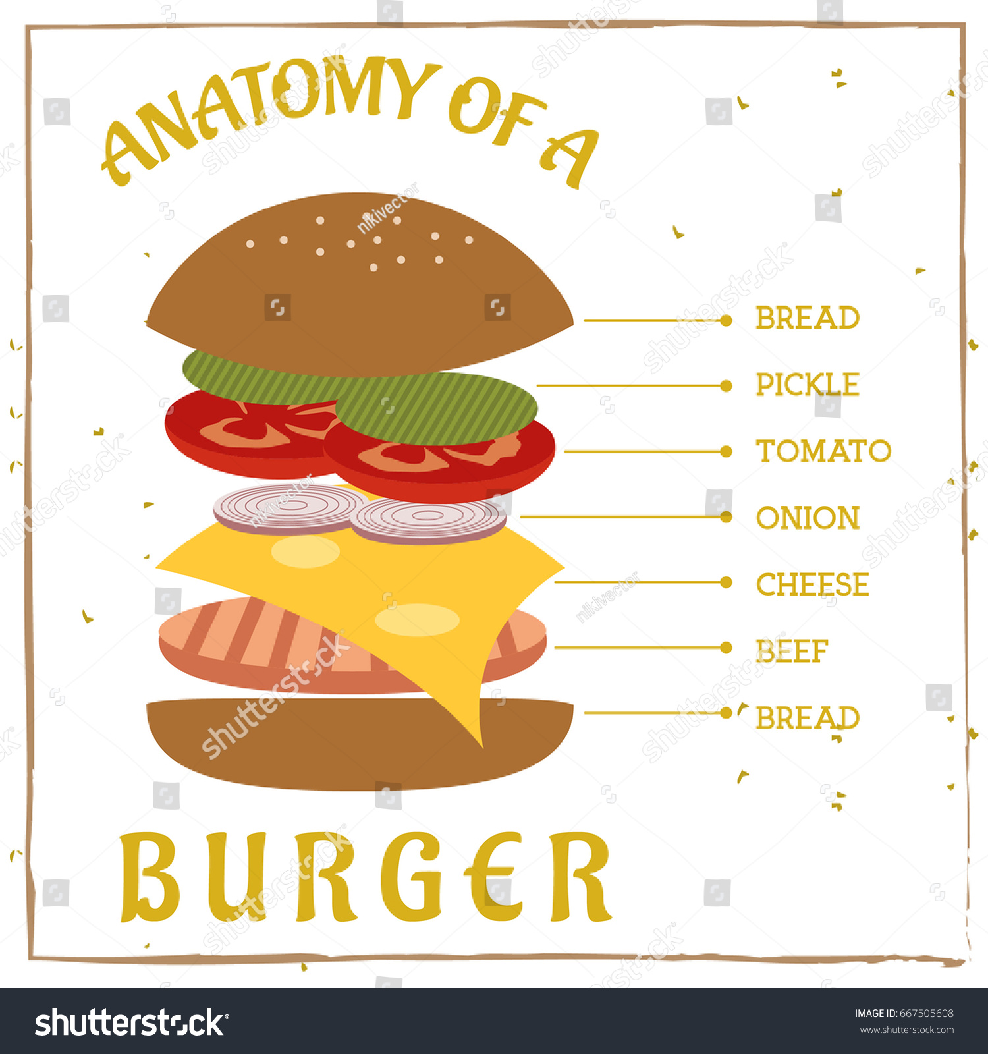

Stack
Top Bun
Lettuce
Tomato
Onion
Cheese
Beef Patty
Bottom Bun

Slide 11
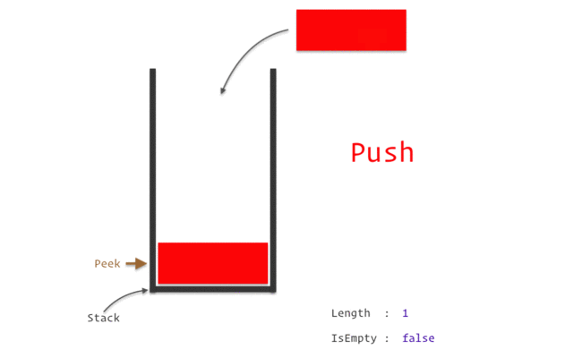
LIFO principle
Notes:
In a stack,
Removing an element is called pop.
Inserting an element is called push.

Slide 12
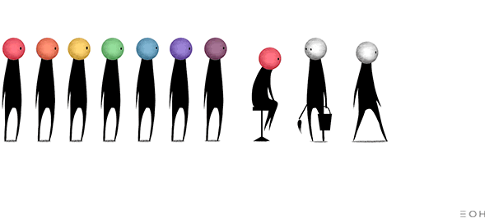
Queue
Elements are arranged in a queue.
The first element will be at the front.
The last element will be at the rear.
Follows the FIFO (First in First out) principle.
Notes:
When you go to a packed restaurant on a holiday. You sign on a waiting list.

Slide 13
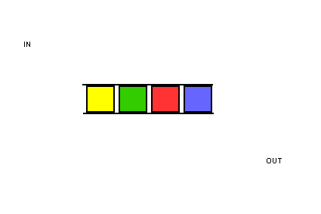
FIFO principle
Notes:
In a queue,
Inserting an element is called enqueue.
Removing an element is called dequeue.

Slide 14
Linked List
Is a sequence of linked/connected elements is known as a node.
Each node contains a connection to another node in form of a pointer.

Slide 15
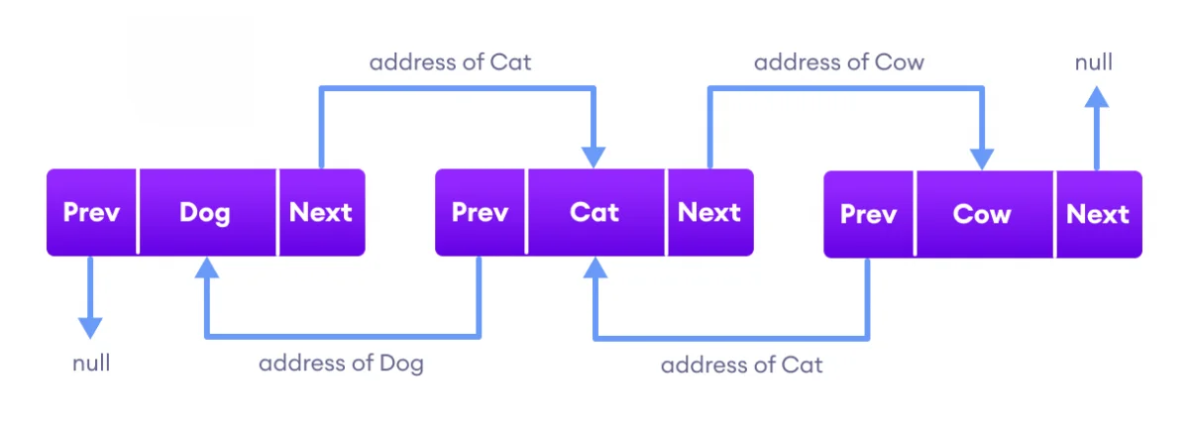
Linked List
Notes:
The previous pointer contains the address of the preceding node
The next pointer contains the address of the succeeding node.

Slide 16
Non-linear Data Structures
Unlike linear data structures, data in non-linear data structures are not in any order.

Slide 17
Tree
A tree is a non-linear hierarchical data structure that consists of nodes connected by edges.

Slide 18
Node and Edge
Node
A
Edge
Edge
Node
B
C
Node
Edge
Edge
Edge
Edge
Node
D
E
Node
F
Node
G
Edge
Edge
Node
H
I
Node
Notes:
Nodes:
The elements that makes up the tree
Edges
The connection between two nodes.

Slide 19
Root, Parent, Child, Leaf
Root
A
Level 0
Parent Node
B
C
Level 1
Child Node
D
E
Leaf Node
F
Siblings
G
Level 2
H
I
Level 3
Notes:
Root
node at the top of the tree
Parent
A node except the root node that has one edge down to another node.
Child
A node that has one edge up to another node.
Siblings
Two or more nodes that have the same parent node.
Leaf
A node without any child nodes.

Slide 20
Height and Depth
Height = 3
Depth = 0
A
Height = 2
Depth = 1
B
C
Height = 0
Depth = 1
Height = 1 Depth = 2
D
E
Height = 0 Depth = 2
F
Height = 0
Depth = 2
G
Height = 0
Depth = 2
Height = 0
Depth = 3
H
I
Height = 0
Depth = 3
Notes:
Height of a node
- The number of edges from the node to the deepest leaf
Count starts at zero
Depth of a node
- The number of edges from the root to the node.
- Count starts at zero

Slide 21
Degree of a node
A
Degree of node A = 2
B
C
D
E
F
G
H
I
Notes:
Degree of a node
- The number of its children

Slide 22
Degree of a node
A
Degree of node B = 2
B
C
D
E
F
G
H
I

Slide 23
Degree of a node
A
B
C
Degree of node D = 2
D
E
F
G
H
I

Slide 24
Degree of a node
A
B
C
Degree of node C = 2
D
E
F
G
H
I

Slide 25
Degree of a node
A
B
C
D
E
F
G
H
I
Degree of nodes H, I ,E F, G = 0

Slide 26
Graph
A graph data structure consists of:
A collection of vertices.
A collection of edges, represented as ordered pairs of vertices.

Slide 27
Terminologies
Vertices
Vertex
Edge
Adjacency
Path

Slide 28




What is a Graph?
Jane
Ronn
Vertices:
Jane, Nica, Jonnah, Ronn
Edges:
Jane - Nica
Jane - Jonnah
Jane - Ronn
Nica - Jonnah
Jonnah
Nica

Slide 29
Adjacency
A vertex is said to be adjacent to another vertex if there is an edge connecting them.

Slide 30
Adjacency
Jane
Ronn
Jane is adjacent to Nica, Jonnah and Ronn.
Ronn is not adjacent to Jonnah.
Jonnah
Nica

Slide 31
Path
A sequence of edges that allows you to go from vertex A to vertex B is called a path.

Slide 32
Path
Jane
Ronn
Path from Nica to Ronn:
1. Nica to Jane.
2. Jane to Ronn.
Jonnah
Nica

Slide 33
Types of Graphs

Slide 34

Directed Graph
A graph in which an edge has a direction.
Tristan
Jane

Slide 35

Undirected Graph
A graph in which an edge does not have any direction.
Nica
J-Rhyzz

Slide 36
Connected Graph
A graph where every node can be visited from other nodes.
Jane
Tristan
J-Rhyzz
Nica

Slide 37
Disconnected Graph
A graph in which at least one node is not reachable from a node.
Jane
Tristan
J-Rhyzz
Nica

Slide 38
Complete Graph
A graph in which each node has edges to all other nodes
Jane
Tristan
J-Rhyzz
Nica

Slide 39
Weighted Graph
A weighted graph is a special type of graph in which edges are assigned some weights which represent cost, distance.
1
2
Jane
Tristan
J-Rhyzz
3
4
Nica

